Slide 1
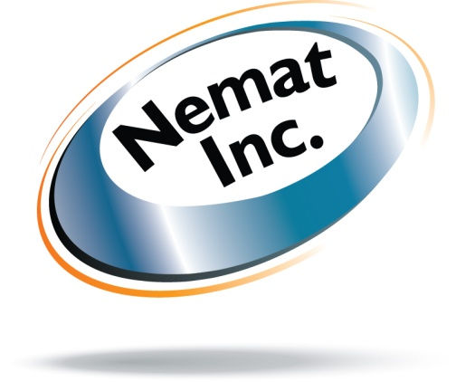
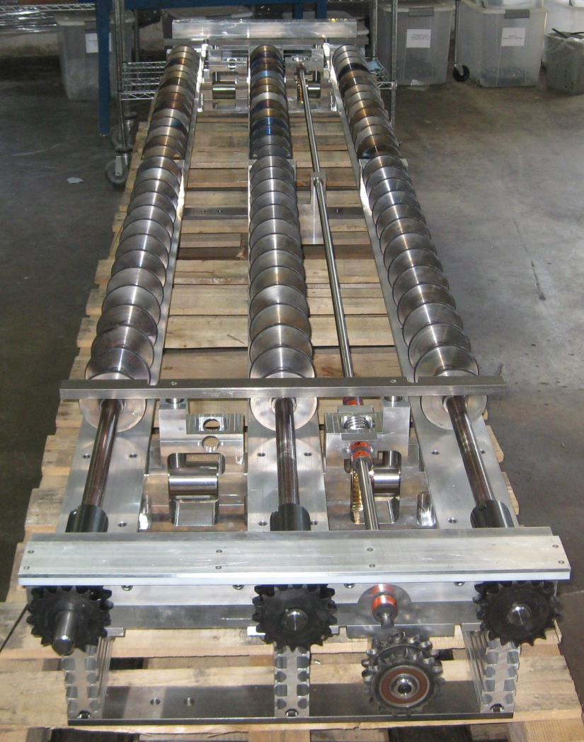

Coating Technologies,
Contract Manufacturing
“Trusted supplier to the coating technology entities in Fairfield, Ca. since early 1980’s.”
Developed By:
Nemat Inc.
19225 Road 24
Madera, CA
USA
www.nemat.com

Slide 2
Table of Contents:
About Us
Contract Manufacturing
Products
Quality Assurance
Design For Manufacturability/Lean Manufacturing

Slide 3
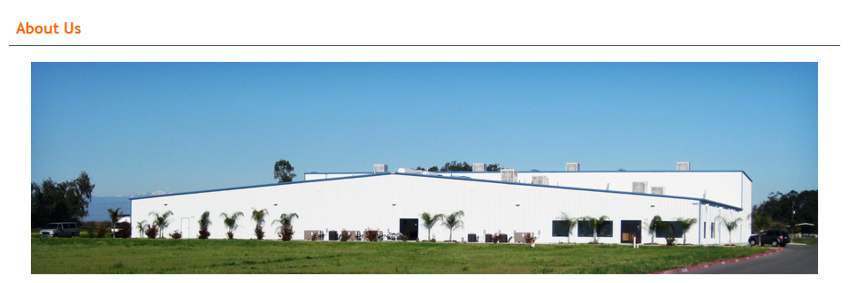
Nemat Inc., established in 1994, is a United States manufacturer of components and assemblies for coating technology companies. Nemat Inc., provides Contract Manufacturing, Design Engineering and Management Consulting services. The objective of the company is to provide high quality products with substantial cost savings compared to other coating technology OEM’s.
In September of 2004, Nemat Inc. acquired Quality Precision Inc, a trusted supplier primarily to the coating technology entities in Fairfield, California; at the time known as Vacuum Coating Technology (VACT). Quality Precision Inc had been successfully manufacturing products for this facility since early 1980’s and throughout the changes in ownership from Temescal, to Airco, to BOC , to Von Ardenne, to VACT.
Nemat Inc., reorganized Quality Precision, expanded product lines/services, and strengthened the relationship with VACT. The relationship made Nemat Inc. stronger as VACT was acquired by Applied Films and finally Applied Materials. Nemat Inc. manufactured over 80% of components and sub-assemblies for VAC-MAG end block. Nemat Inc. was the number one supplier to AMAT, Fairfield at the time of the closure of that facility. Upon this closure, Nemat Inc. promptly transitioned to providing products to end users such as; Guardian, Cardinal, AGC, Vitro, and other coating companies. This was a simple transition as Nemat Inc. had a large inventory of such products and was able to provide substantial cost savings directly to the end users. This business model is still in existence to present day.
In June of 2009, with increased demand for company’s products and services, all divisions were relocated to a brand new Greenfield 40,000 Sq. Ft. facility in Madera, Ca..

Slide 4
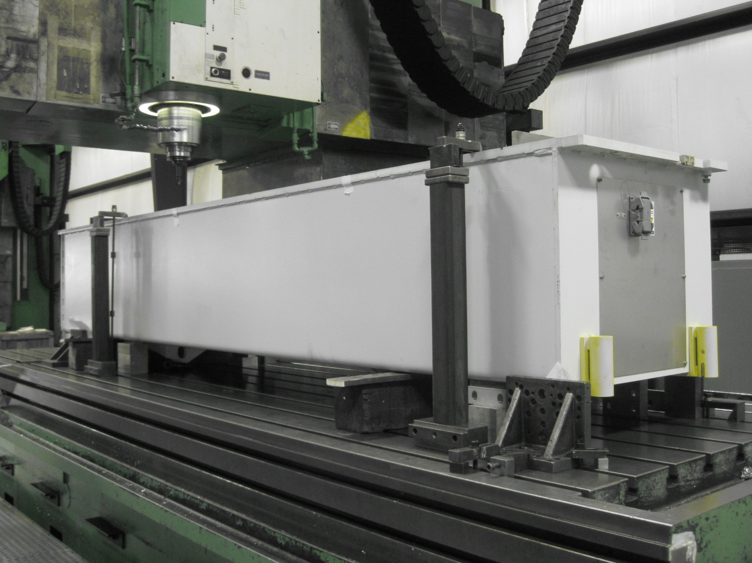
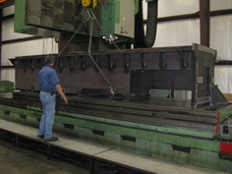
Vacuum Coating Equipment manufacturing
We are a United States supplier of high-quality/low-cost components, assemblies, small chambers, and systems to vacuum coating technology companies and end users. We have the expertise and technology required to develop and manufacture state of the art vacuum coating equipment.
Our expertise in “Design for Manufacturability” and “Lean Manufacturing” enables us to quickly develop designs and processes that exceed our customers’ expectations.
We design and manufacture systems using specification from prints developed in the USA, Germany, Japan, and other parts of the world, both in SI and Metric systems.
We have the relationships required to provide successful turnkey projects with substantial cost savings by utilizing other suppliers.

Slide 5
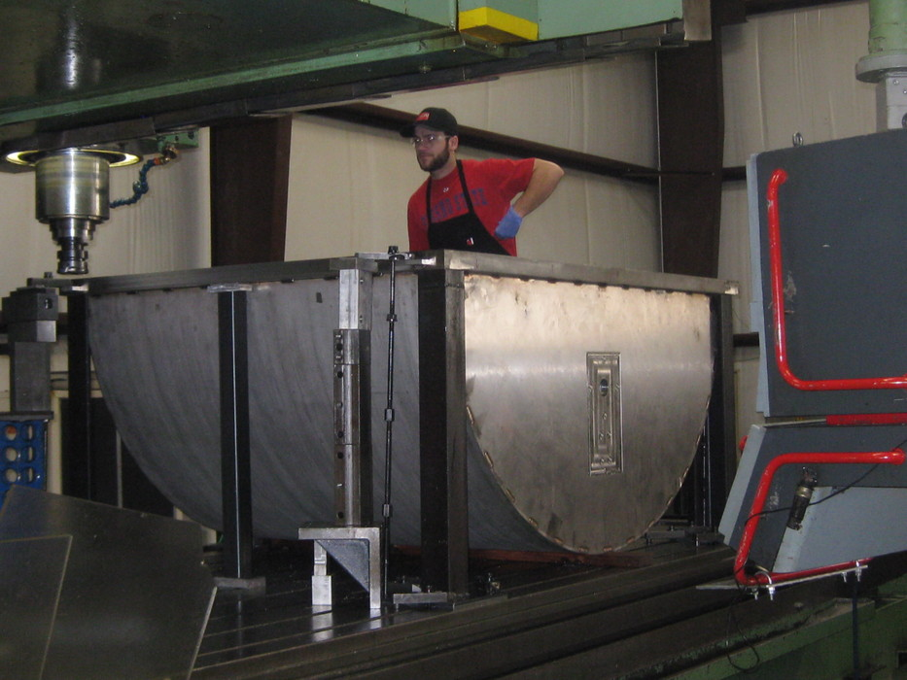
Coating Technologies, Contract manufacturing
Manufacturing Services
• CNC Milling & Turning
• Large Capacity CNC Milling and Turning
• Automated CNC Drilling & Milling
• CNC Horizontal Milling
• CNC Tube Bending
• Center-less Grinding
• Conventional Milling
• Conventional Turning
• Laser and Water-Jet Cutting
• Stamping & Forming
• Fabrication
• Welding (TIG, MIG, Vacuum)
• Helium Leak Testing
• Hydro-Static Pressure Leak Testing
• Grit Blasting
• Anodizing
• Plating
• Powder Coating
• Galvanizing
• Electro-Mechanical Assembly and Integration
• Testing for Electro-Mechanical Assemblies

Slide 6
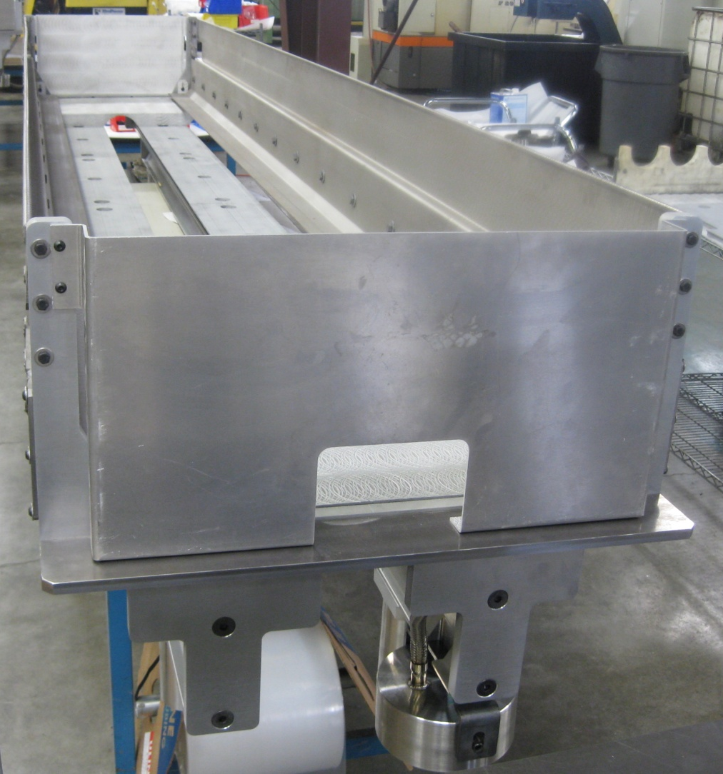
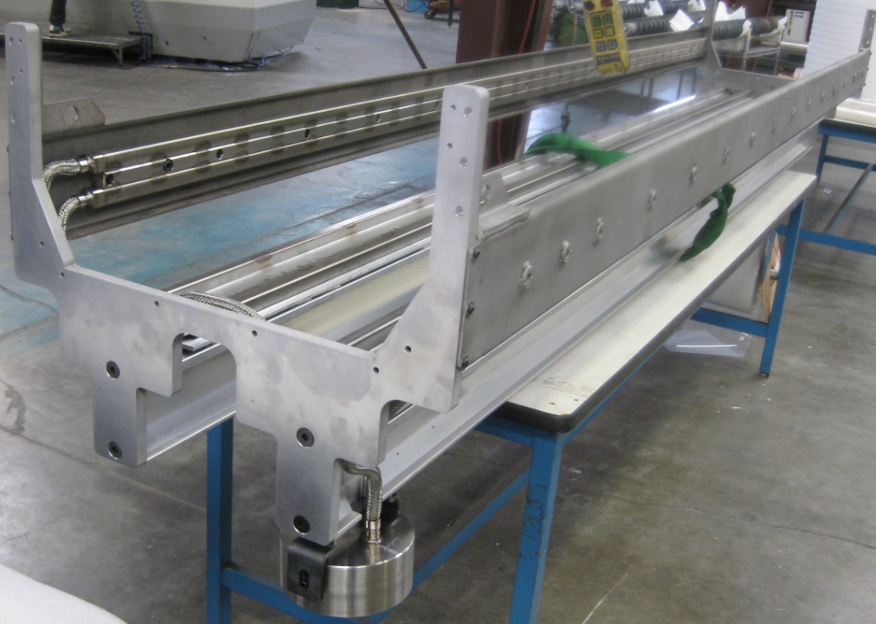
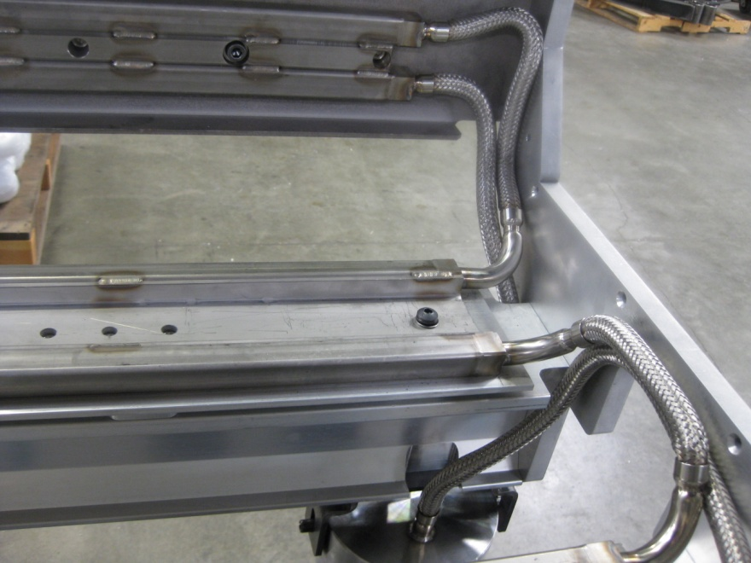
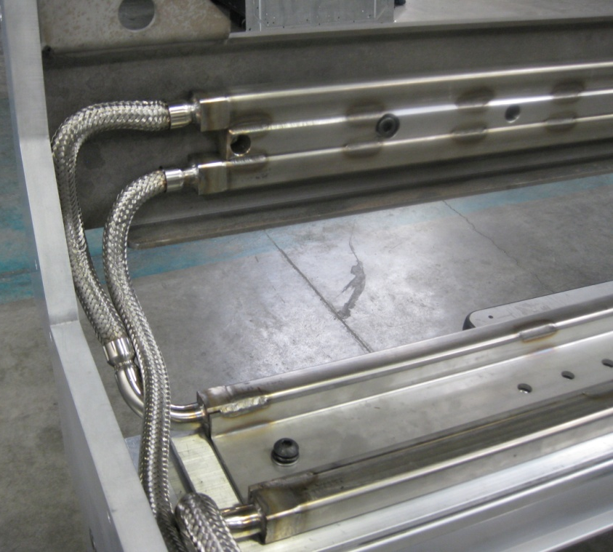
Products
77% Increase in water capacity, resulting in improved cooling.

Slide 7
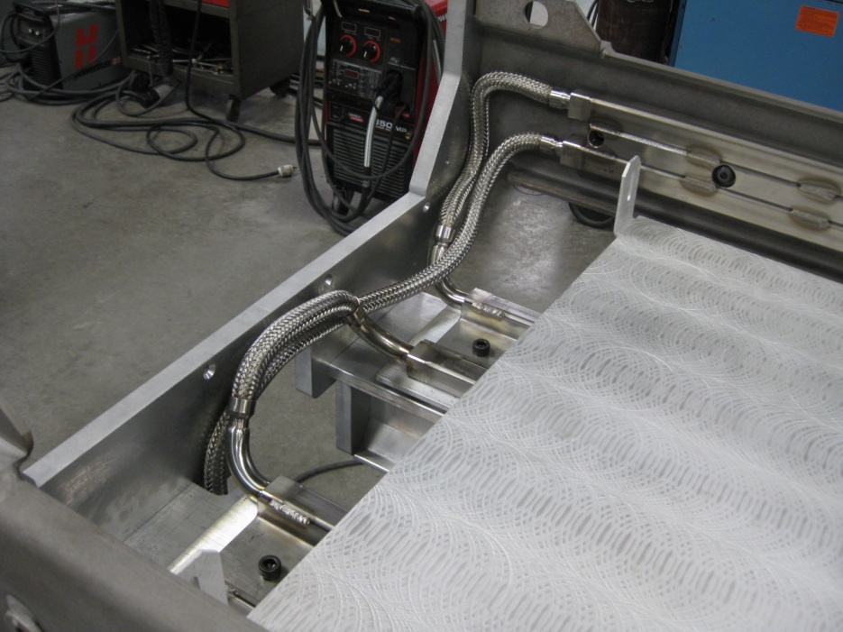
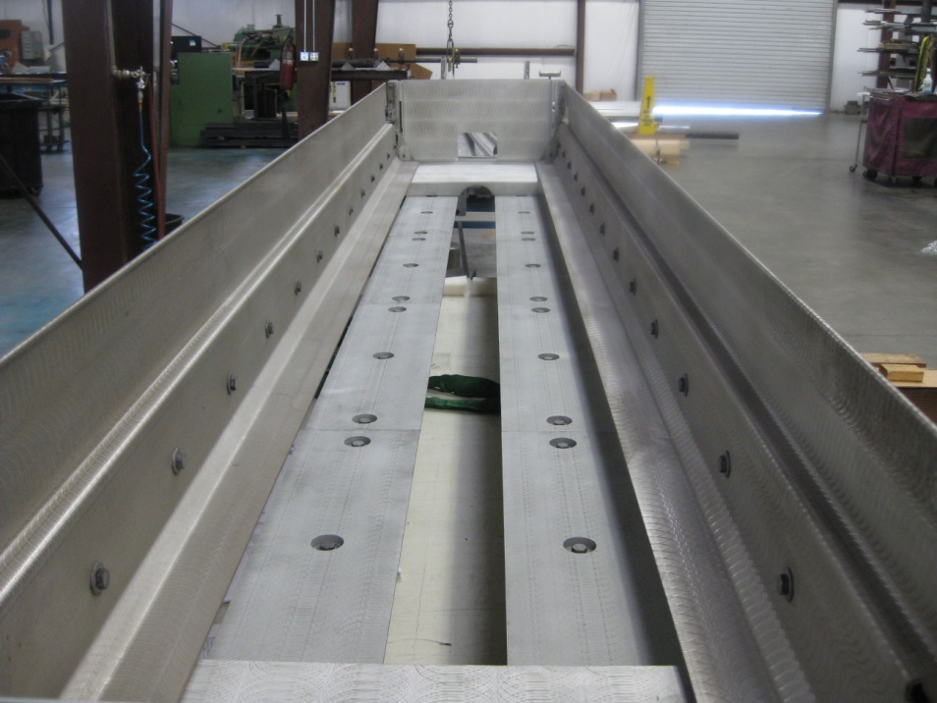
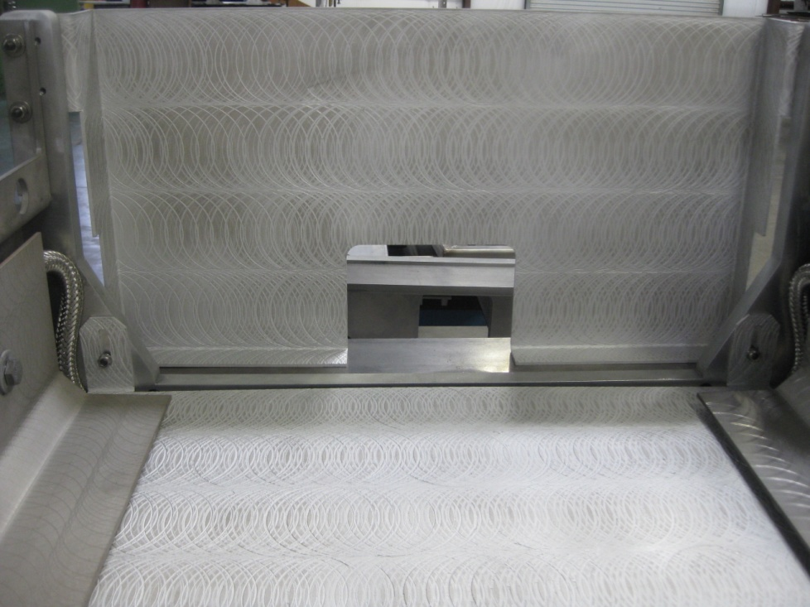
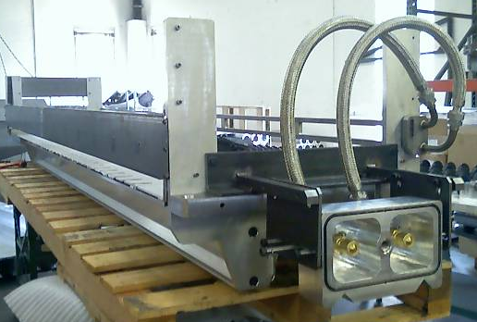
Products

Slide 8
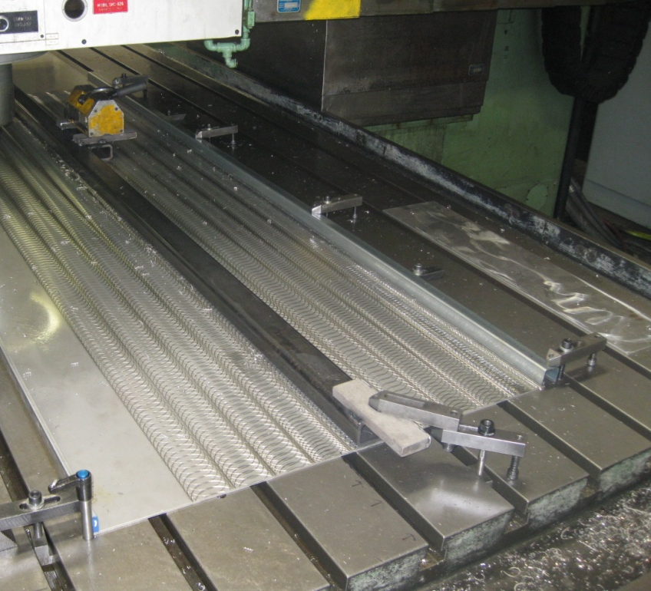
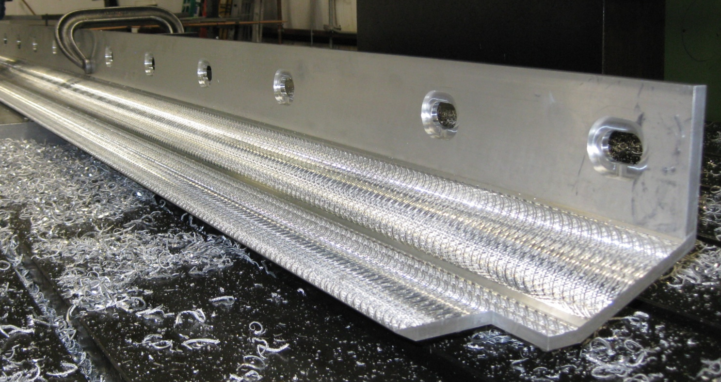
Swirl Finish Development:
Nemat Inc., has developed a technology to reduce Debris build up and popping. This technology has increased run time and reduced number of vents per year.
Products

Slide 9
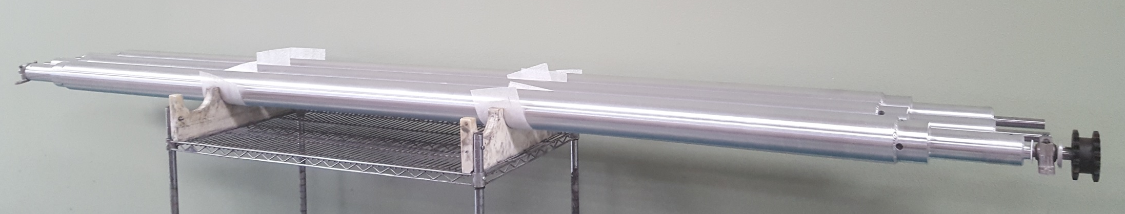
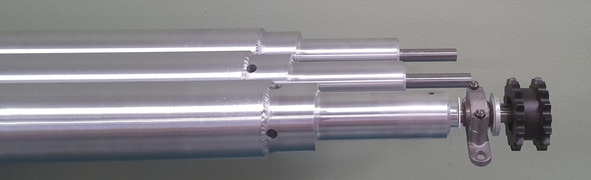
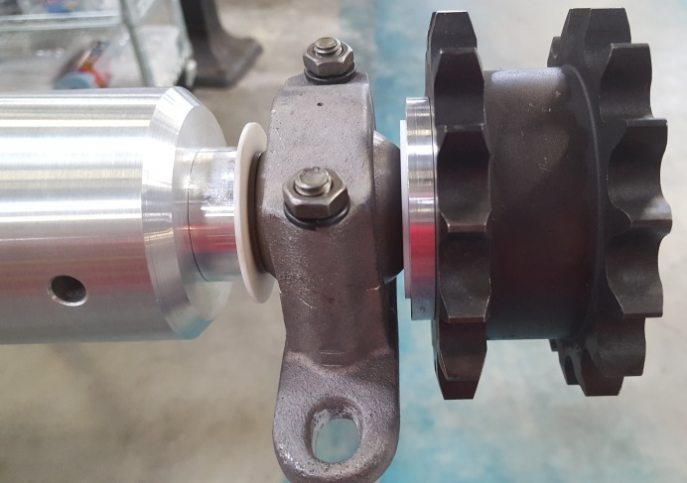
Products
100” Roll

Slide 10
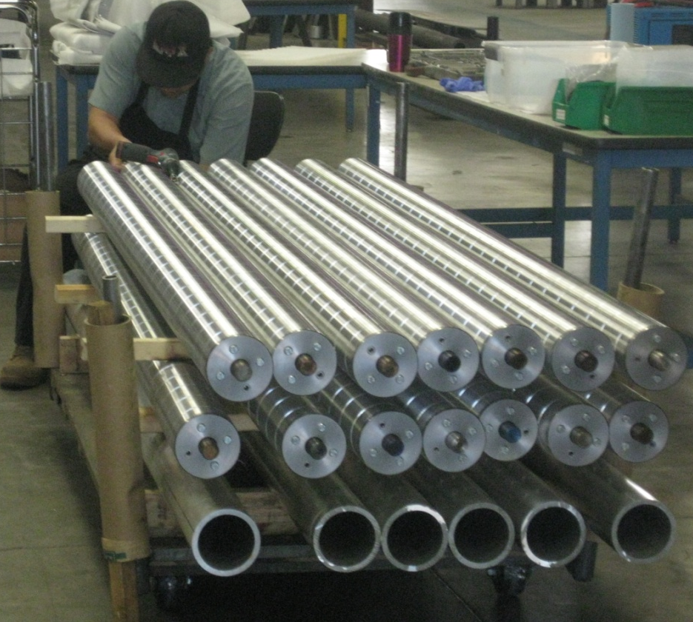
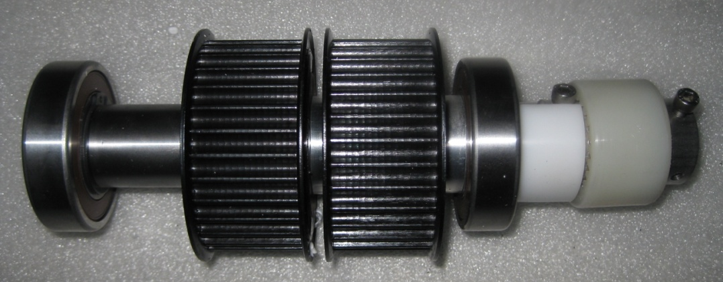
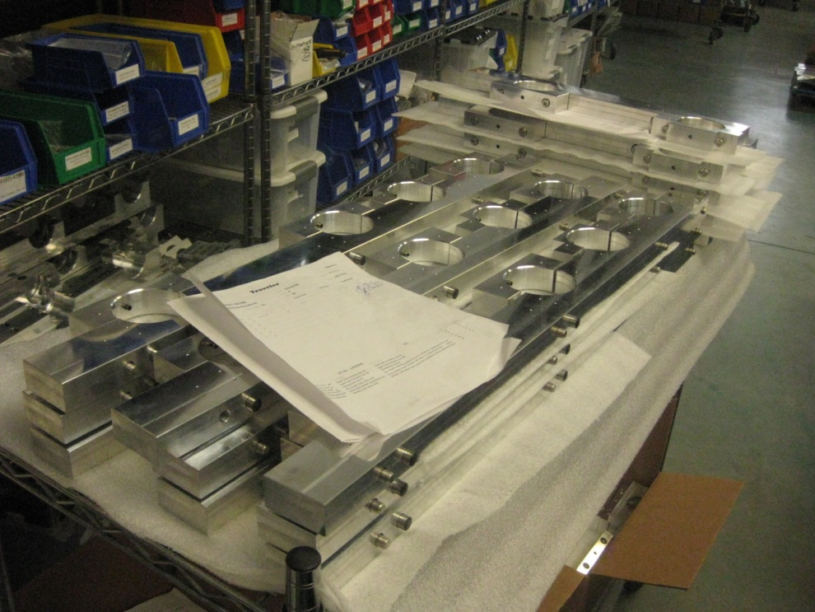
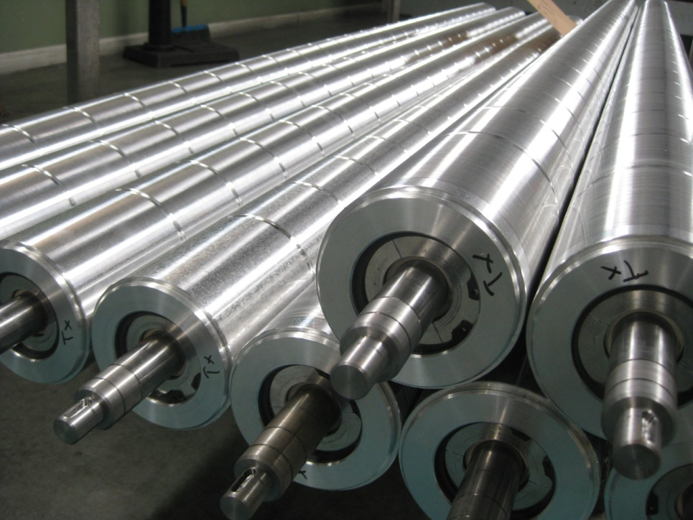
Products

Slide 11
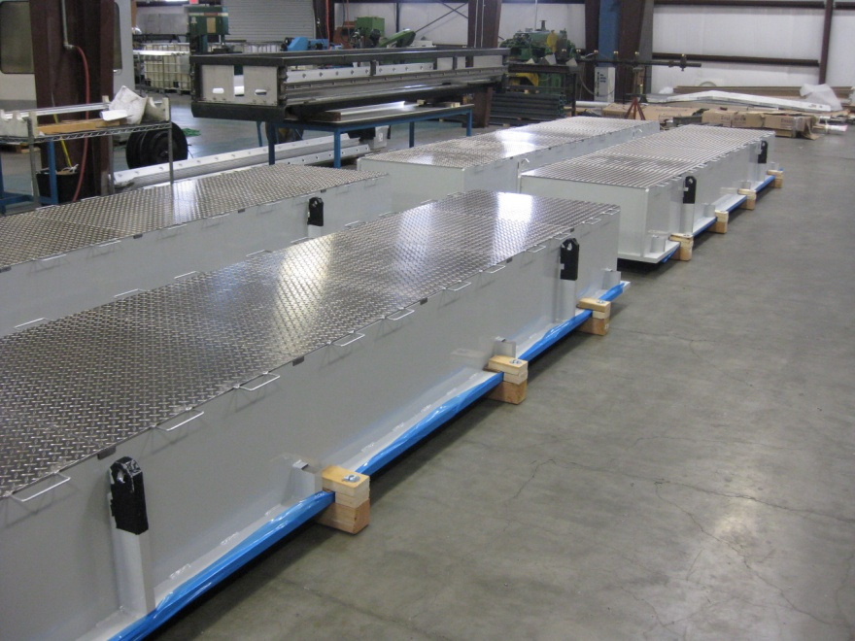
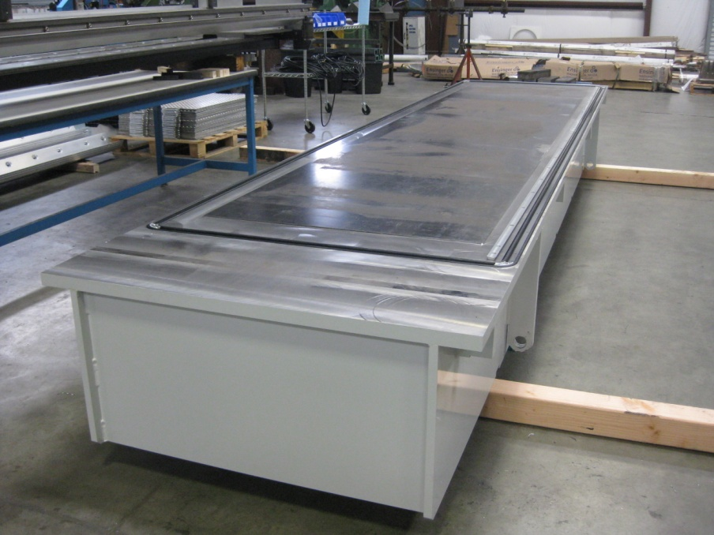
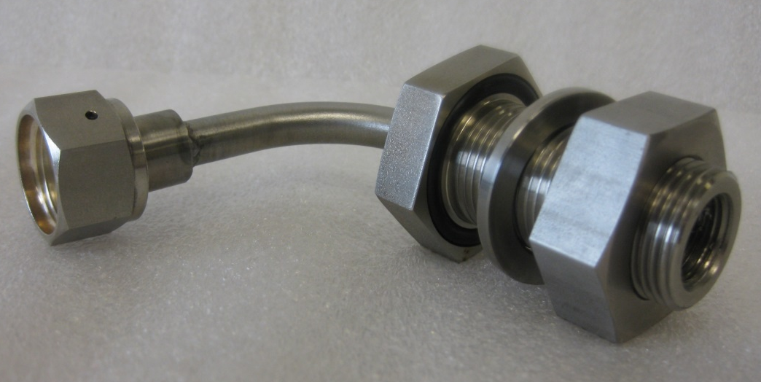
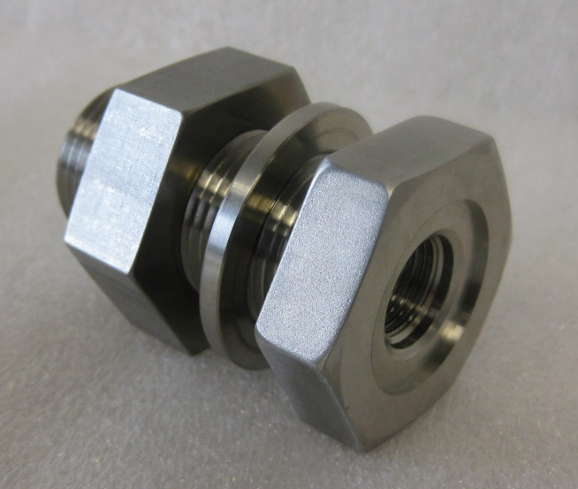
Products

Slide 12
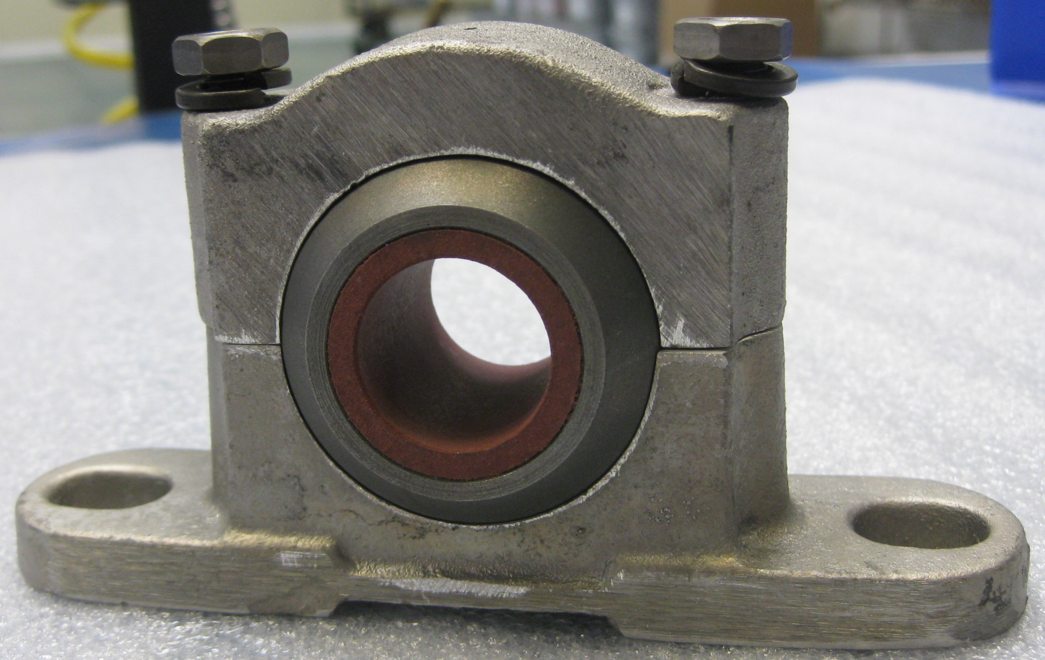
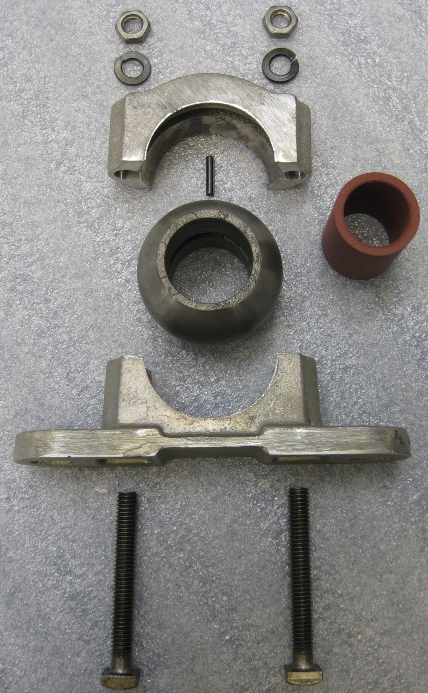
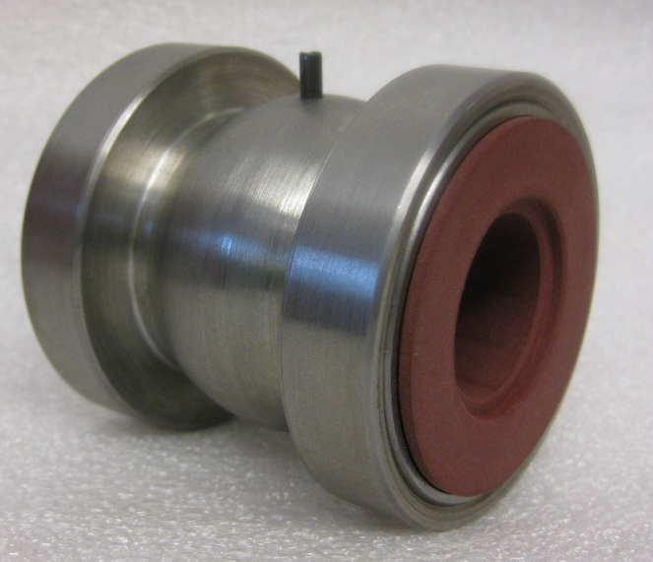
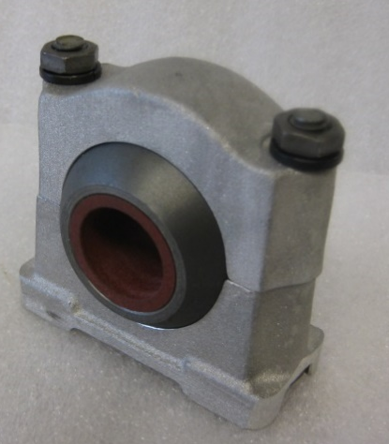
Products

Slide 13
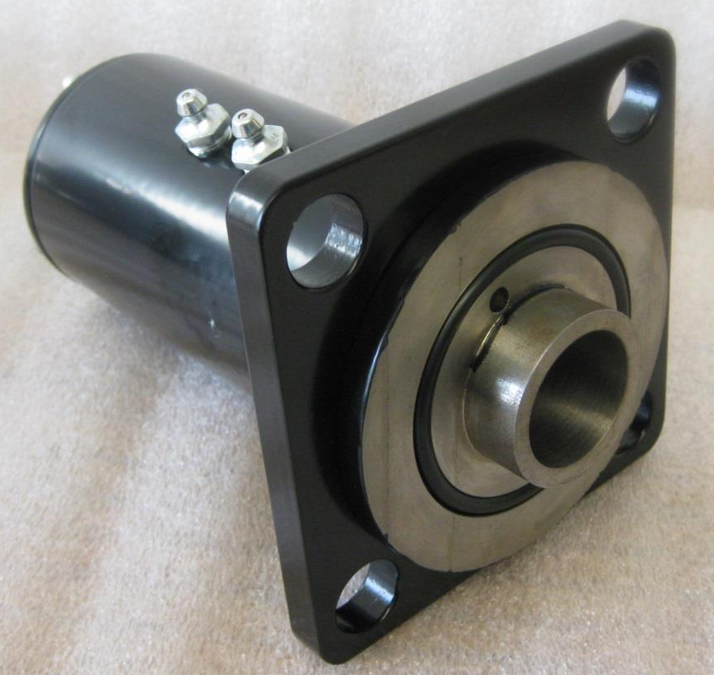
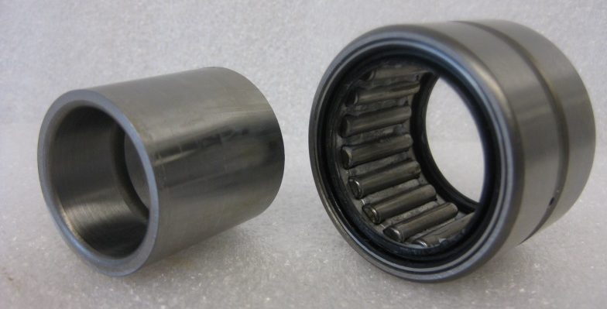
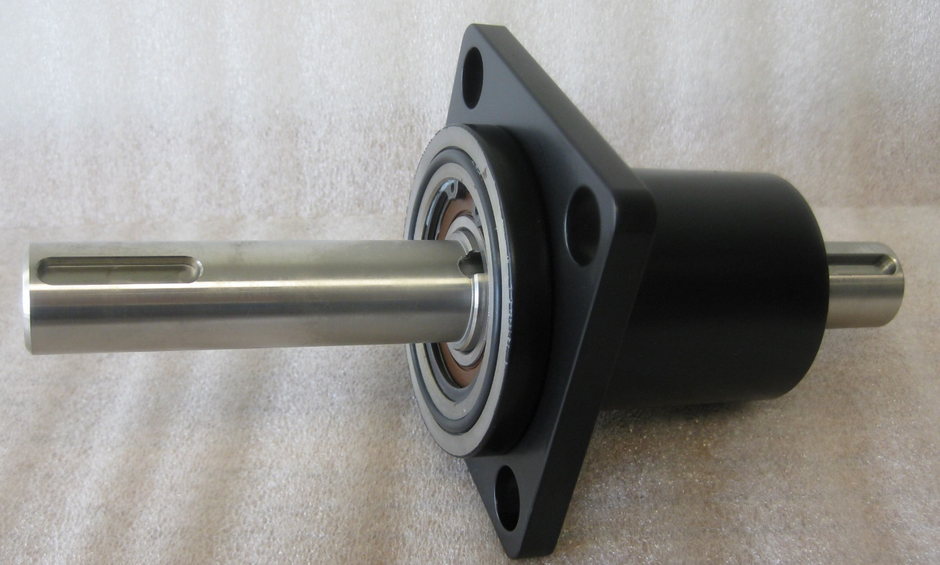
Products

Slide 14
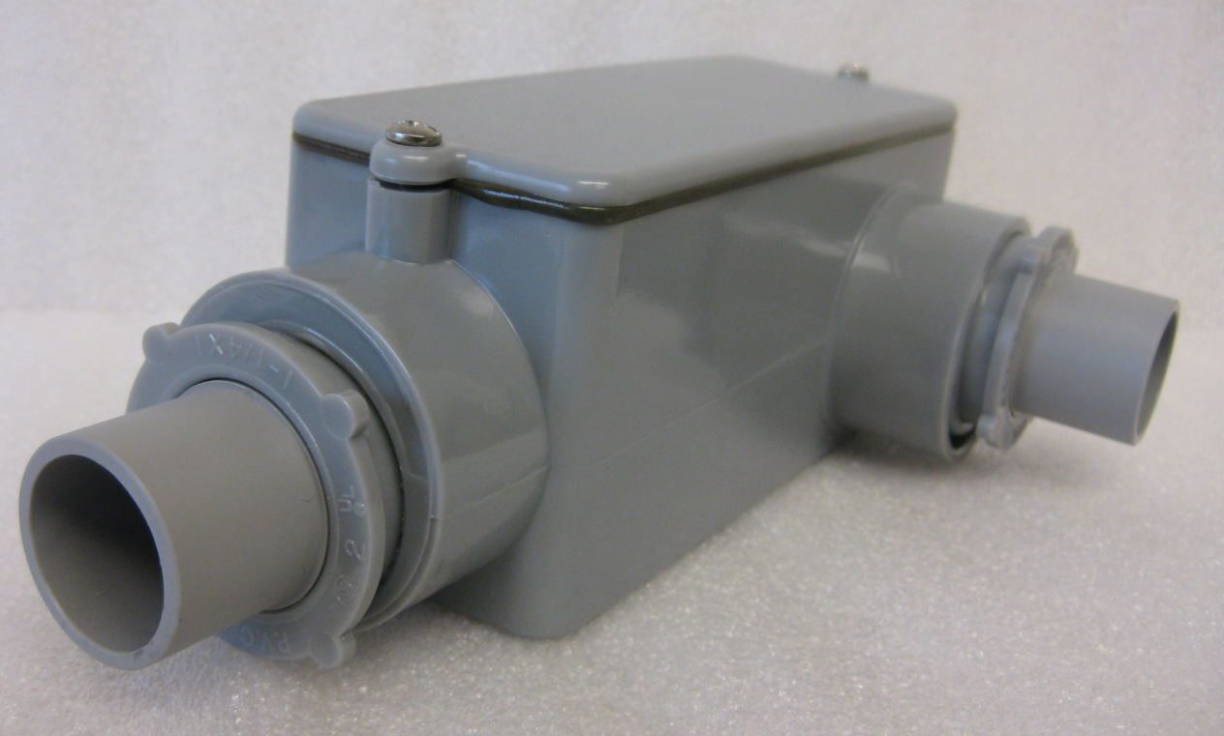
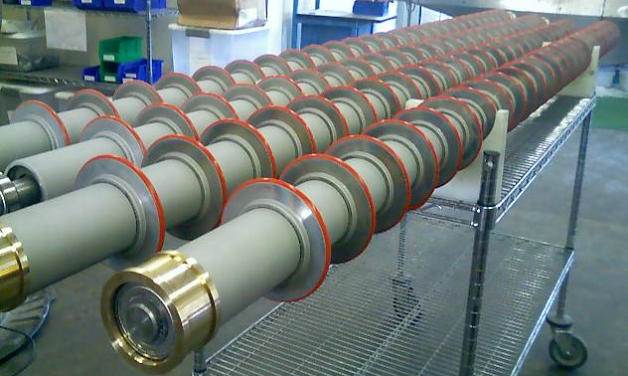
Products

Slide 15
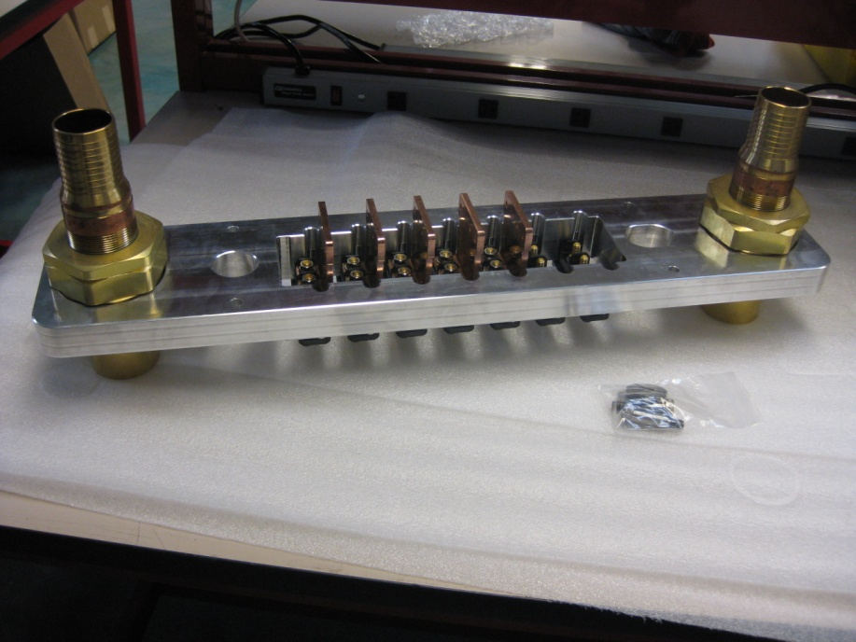
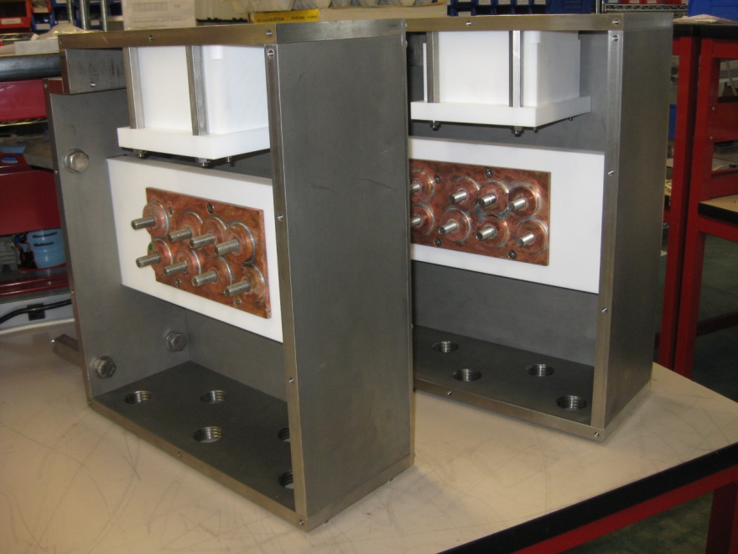
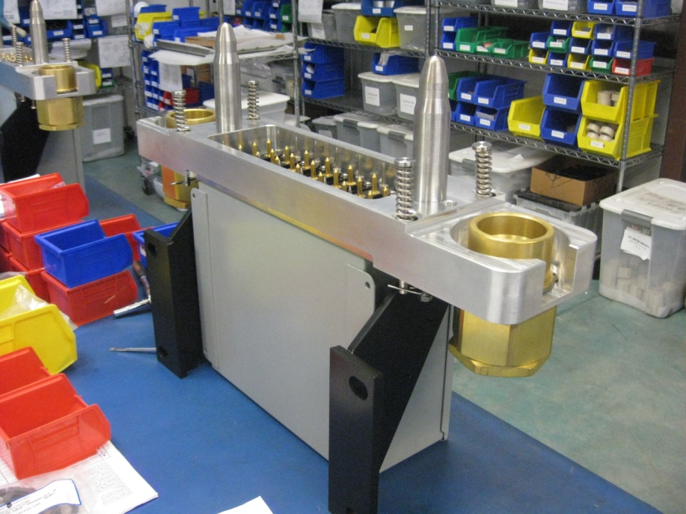
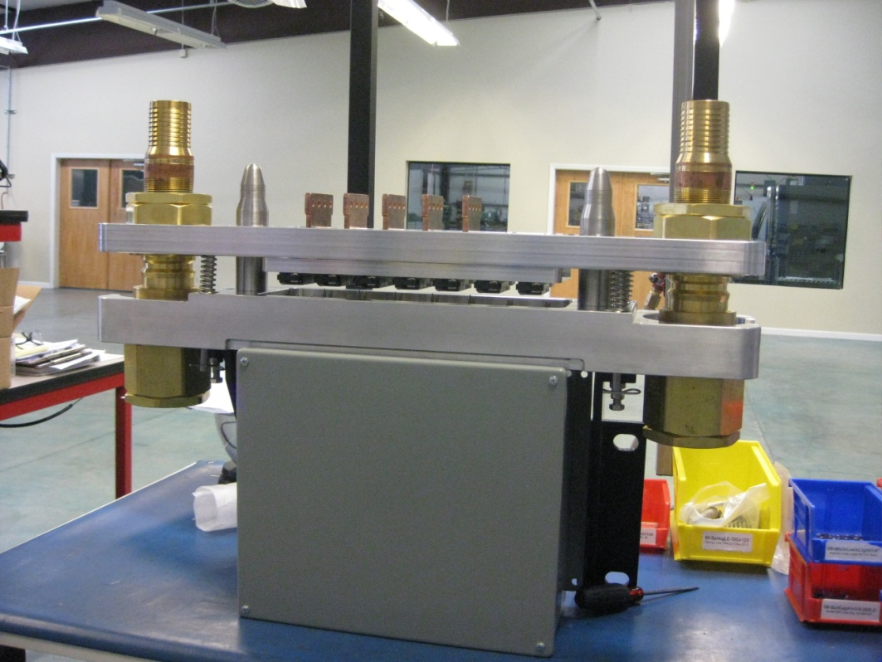
Products

Slide 16
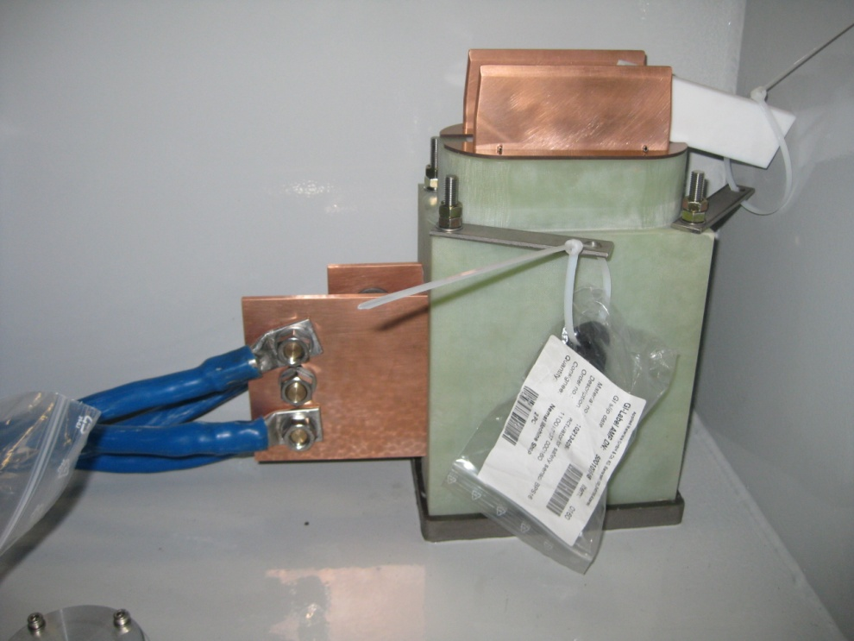
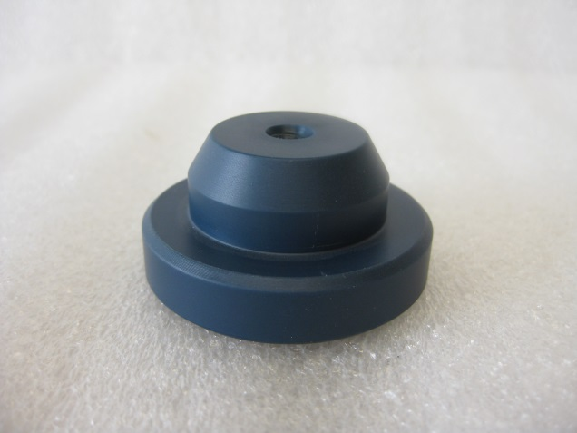
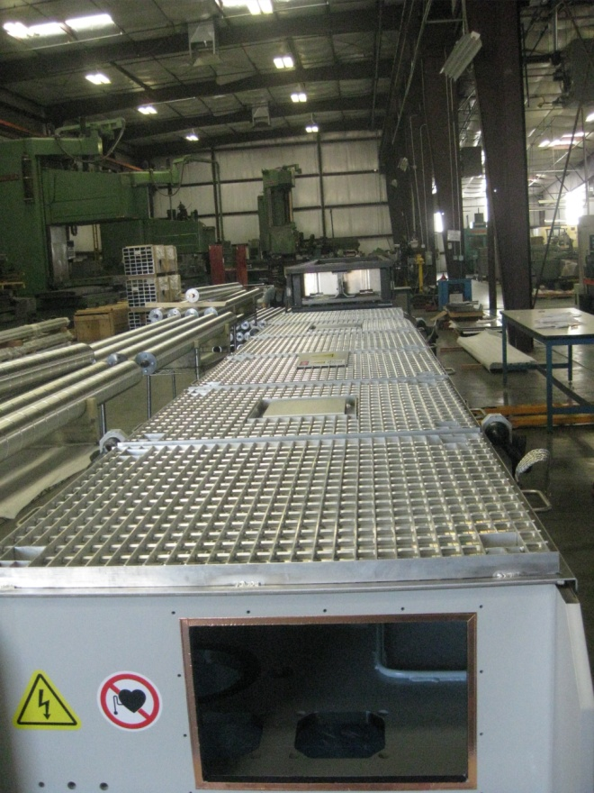
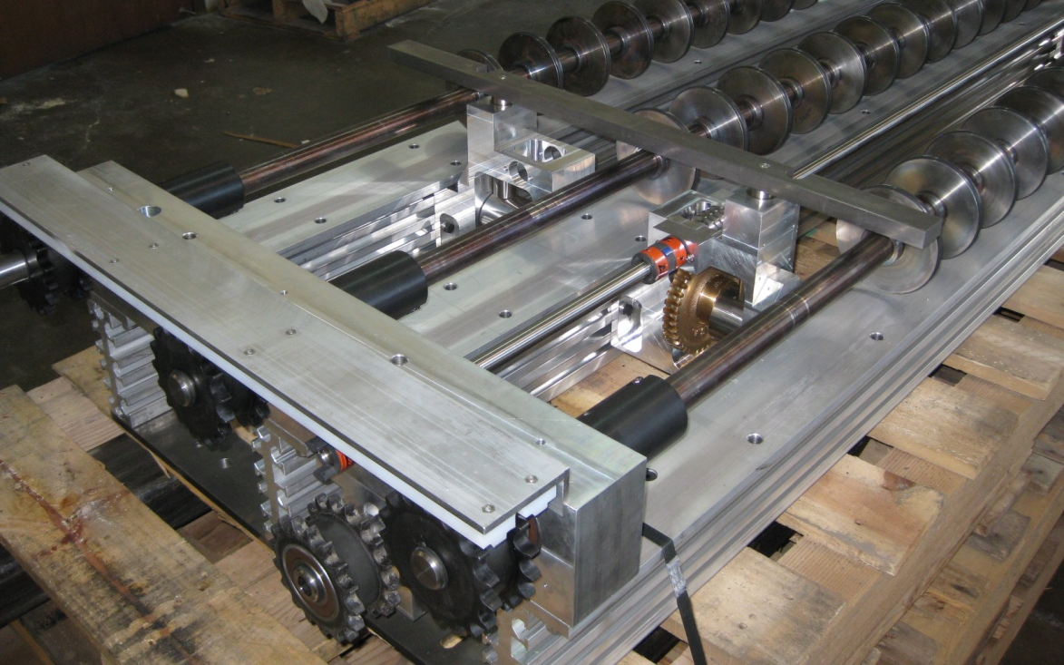
Products

Slide 17
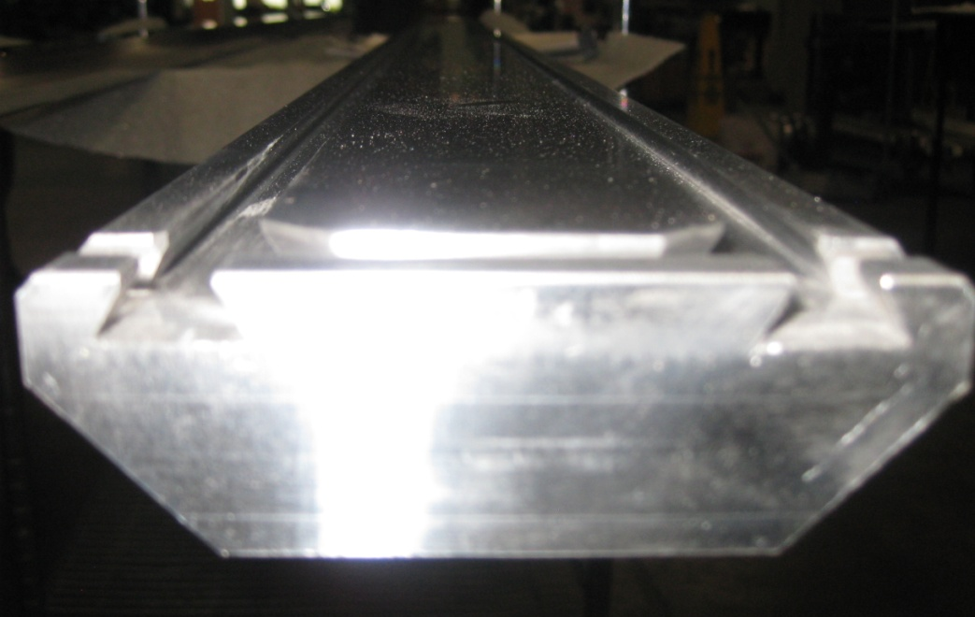
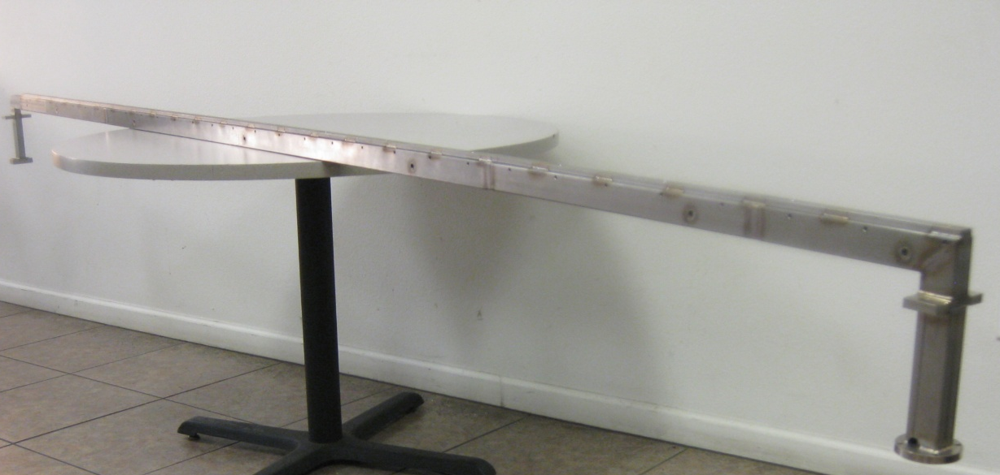
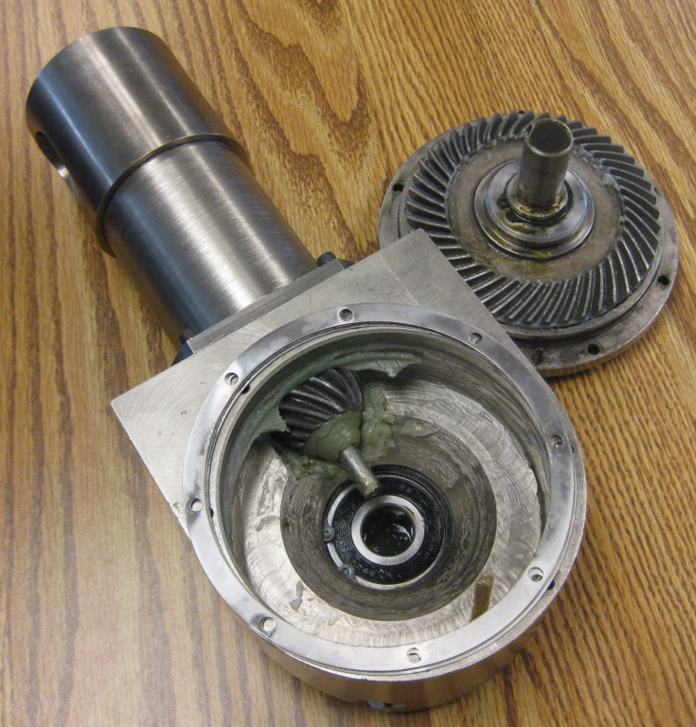
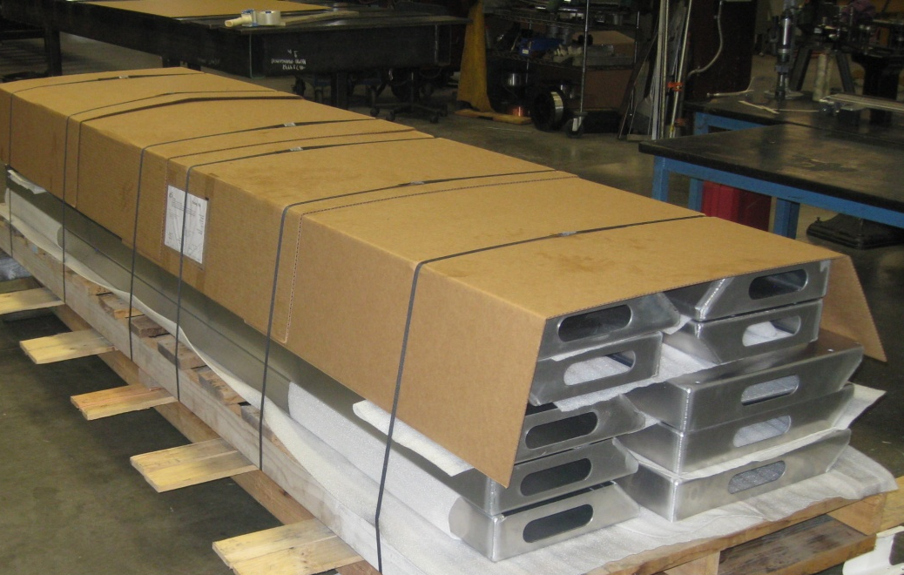
Gate Slit Valves Assemblies
Single & Multi Segment Gas Bar
Products

Slide 18
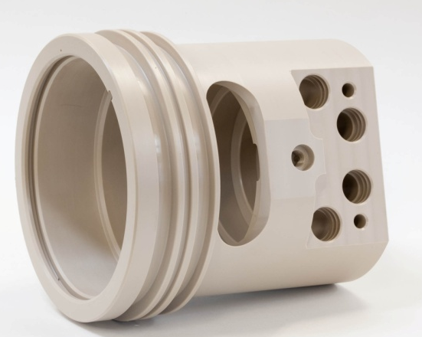
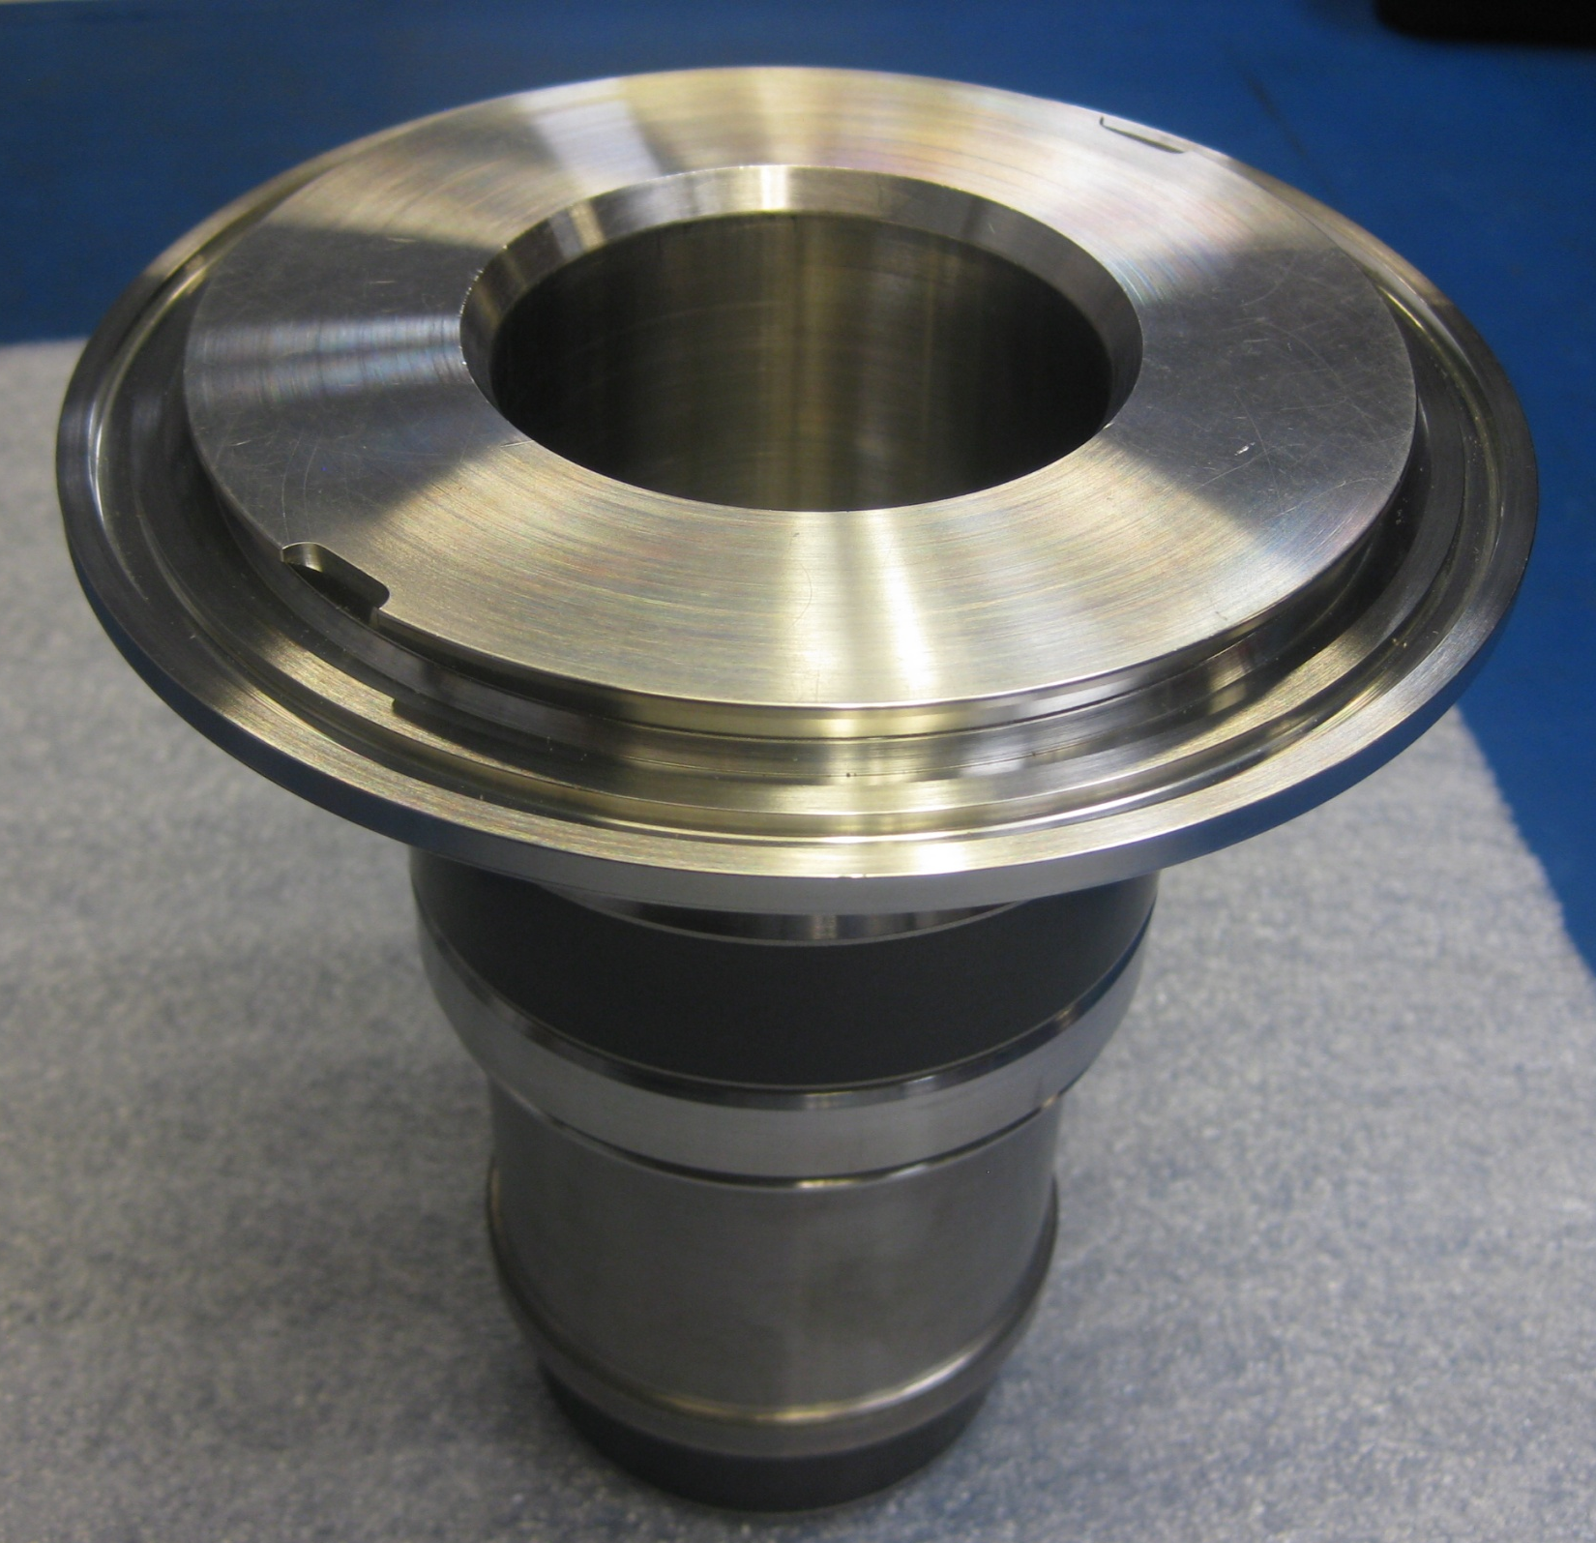

Products

Slide 19



Products

Slide 20




Products

Slide 21




Products

Slide 22




Products

Slide 23




Products

Slide 24




Products

Slide 25


Products

Slide 26
Quality Assurance
Policy
Nemat Inc. Quality Assurance Policy is to meet customer’s specifications as noted on the products drawings and standards. We will strive to exceed these specifications if it can be accomplished without sacrificing cost or lead time objectives. All specifications MUST be communicated and updated in writing; hence verbal communications are not accepted.
This is accomplished by thoroughly understanding customers’ specification and developing a “Capable Process” to achieve them. This process is documented and is used as “Standard Work”. All employees MUST follow this process exactly to assure compliance with “Copy Exact” expectations.
Employees performing work are ultimately responsible to produce products to set specifications. A “Check-Do-Check” in process procedure is established to increase the possibility of identifying and correcting errors as they occur in real time. This process is implemented from Order Entry to Engineering/Programming to Production and through the Shipping processes.
The Quality Assurance Department is established to monitor adherence to processes and specifications for internal and contracted work. This is accomplished by developing quality standards and ensuring employees’ and suppliers’ adherence to such standards. All employees and Quality Assurance personnel are authorized to stop any non-conformance and escalate the issue up to and including the customer. Issues MUST be reviewed, root caused, and corrected expeditiously.
We guarantee conformance to specifications and stand behind the products and services we provide. Our performance reviews, reward programs, and disciplinary action policy are developed based on employees following quality standards and producing quality products and services.

Slide 27












Quality Assurance
Metrology Department, located in an environmentally controlled facility, with:
• Manual and Programmable CNC Coordinate Measuring Machines
• Precision Surface Measuring Equipment
• Microscopes
• Varian Leak Detector
• Hardness Tester
• Optical Comparator
• Conventional Inspection Equipment and Gauges
All inspection equipment is calibrated to MIL-STD-45208 and MIL-STD-45662A calibration system requirements.

Slide 28
Design For Lean Manufacturing
Design For Manufacturability (DFM):
The general engineering art of designing products in such a way that they are easy to manufacture
A design process to make it easy to manufacture a product, part or assembly
The Quality Lever: Cost/Benefit of Investment at Each Stage of Product Development

Slide 29
Design For Lean Manufacturing
Importance of Product / Process Co-Development:
To achieve high manufacturing yields with minimal rework and waste, process capabilities must be matched to product design tolerances.
Focus on Critical Design Elements
Reduced Manufacturing Defects
Reduced Engineering/Process Change Orders
Process Capability Ratio (Cp):
A measure of the ability of a process to hold product tolerances.
The degree of variability in a manufacturing process.
Example:
Designing a Jewelry Box

Slide 30


Lean Manufacturing
Lean Manufacturing is the latest buzzword in manufacturing circles. It is a system / approach to eliminating waste and enabling continuous improvement . It derives from the Toyota Production System or Just In Time Production, Henry Ford and other predecessors.
Fundamentals:
Upper Management Commitment
Total Employee Involvement
Perform Value-Added (VA) and Eliminate/reduce Non-Value-Added (NVA)/wasted activities
Creativity Before Capital
Focus Areas:
Continuous Process Improvement Continuous Quality Improvement
Total Preventative Maintenance

